Slide 1
Writing Dos and Don’ts
Ms. Eddleston’s Guide to Common Errors and Things to Avoid When Writing Formally

Slide 2
Use Formal Language
Avoid slang, text language, and short-cuts. b/c, w/, and & are not words. ☺

Slide 3
Please do not start a sentence with:
Well I did well on my test.
So I eat so that I will grow. I am so happy!
And I eat meat and vegetables.
Or I eat meat or vegetables.
But I eat meat but not vegetables.
To I eat to be healthy.

Slide 4
Common Errors:
Use could have not could of
Use would have not would of
Use going to not “gonna”
Use by accident not on accident
Use I saw it not I seen it

Slide 5
Common Spelling Errors:
does + not = doesn’t
would + not = wouldn’t
could + not = couldn’t

Slide 6
Common Grammar Errors:
Fast and slow are adjectives.
(Please do not use them as adverbs.)
The fast car won the race. (adjective)
The car quickly won the race. (adverb)
The slow car lost the race. (adjective)
The car drove slowly and lost the race. (adverb)
NOT: The car drove slow and lost the race.
Note: When the weather person on television says, “The roads are slippery; drive slow.” This is incorrect grammar!

Slide 7
Please Avoid the word you in your writing, unless it’s used in dialogue or quotes.
Writers tend to use the word "you" - referring to their reader, who could be absolutely anyone at all.

Slide 8
The following is an example conclusion in an MCAS response:
You will greatly enjoy the new after school activity of crab soccer in the gym. You will have fun, get exercise, and learn soccer rules. That is why you will like my idea of playing crab soccer as a new after school activity here at QRMHS.

Slide 9
Who is likely the you reading the MCAS response?
The reader/evaluator of a Long Composition MCAS response is very often a retired teacher.

Slide 10
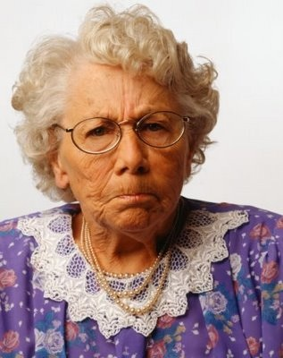
Does she
look like
she would
enjoy to playing crab soccer?

Slide 11
Instead of using You:
People will greatly enjoy the new after school activity of crab soccer in the gym. People will have fun, get exercise, and learn soccer rules. That is why people will like my idea of playing crab soccer as a new after school activity here at QRMHS.

Slide 12
Instead of using You:
Students will greatly enjoy the new after school activity of crab soccer in the gym. Students will have fun, get exercise, and learn soccer rules. That is why Students will like my idea of playing crab soccer as a new after school activity here at QRMHS.

Slide 13
Instead of using You:
My friends will greatly enjoy the new after school activity of crab soccer in the gym. My friends will have fun, get exercise, and learn soccer rules. That is why my friends will like my idea of playing crab soccer as a new after school activity here at QRMHS.

Slide 14
Instead of using You:
One will greatly enjoy the new after school activity of crab soccer in the gym. One will have fun, get exercise, and learn soccer rules. That is why one will like my idea of playing crab soccer as a new after school activity here at QRMHS.

Slide 15
Another MCAS Example Response Issue: the word Will
My friends will greatly enjoy the new after school activity of crab soccer in the gym. My friends will have fun, get exercise, and learn soccer rules. That is why my friends will like my idea of playing crab soccer as a new after school activity here at QRMHS.

Slide 16
Think about it… Would a writer really KNOW if people WILL like his or her idea?

Slide 17
Instead of using Will:
My friends would likely greatly enjoy the new after school activity of crab soccer in the gym. My friends would likely have fun, get exercise, and learn soccer rules. That is why my friends would likely like my idea of playing crab soccer as a new after school activity here at QRMHS.

Slide 18
Instead of using Will:
My friends will likely greatly enjoy the new after school activity of crab soccer in the gym. My friends could have fun, get exercise, and learn soccer rules. That is why I think my friends will like my idea of playing crab soccer as a new after school activity here at QRMHS.

Slide 19
Instead of using Will:
My friends may greatly enjoy the new after school activity of crab soccer in the gym. My friends may have fun, get exercise, and learn soccer rules. That is why my friends may like my idea of playing crab soccer as a new after school activity here at QRMHS.

